Slide 1
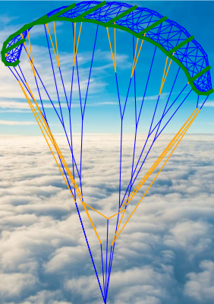
Title slide + image
Fast finite element modelling of bridled leading-edge inflatable kites
Thesis midterm | Patrick Roeleveld

Slide 2
Contents
Limitations PSM model
Nonlinear Finite Element Modelling
Modelling a kite
V3 Model
Static tests
aerostructural coupling

Slide 3
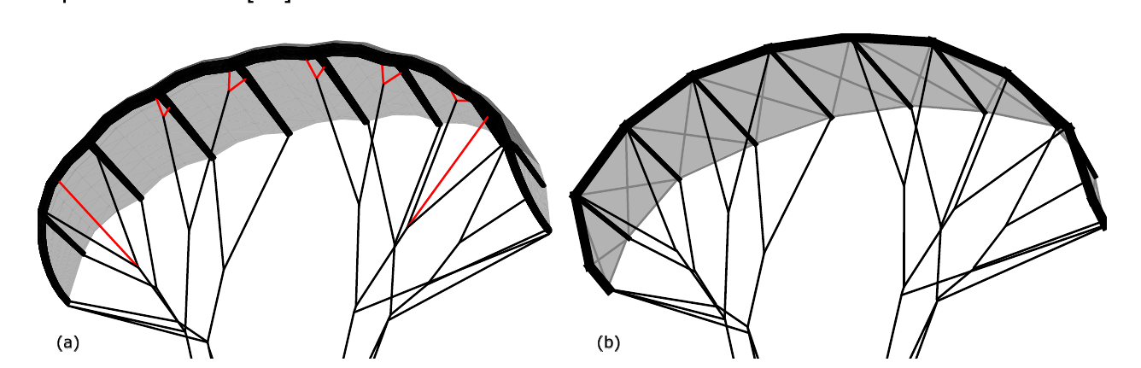
Limitations PSM model
No bending stiffness in leading edge / struts
Simplification of bridle line system
Canopy is flat → unable to model billowing

Slide 4
Nonlinear Finite Element Modelling
Modelling a kite is a nonlinear task due to
  Geometric nonlinearity → Shape and orientation of kite and bridle changes
  Material nonlinearity → Canopy material, Inflatable beams
  Force nonlinearity → Aerodynamic forces change due to shape
Therefore, iteration is required to converge to a solution.
Each iteration the linear equations are set up and solved
Deformation
Solve new linear equations

Slide 5
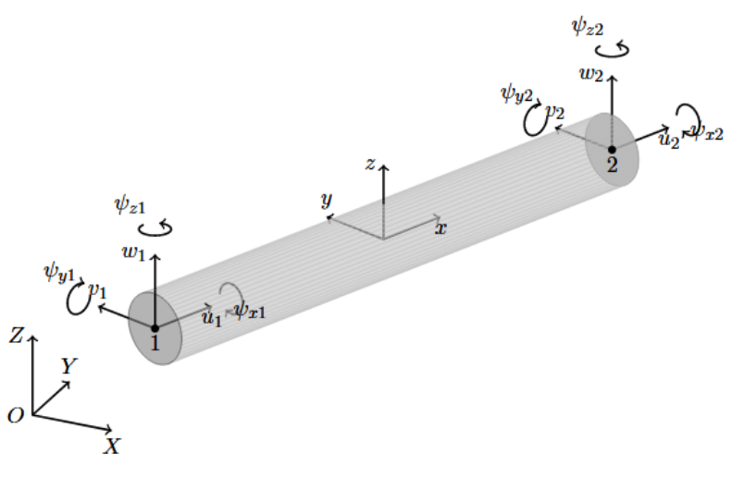


Nonlinear Finite Element Modelling
Model consists of two node elements in 3D space
12 Degrees of freedom per element. Stored in displacement vector u
Element stiffness matrix K, set up using material properties.
Element displacements obtained by solving
Element has a local coordinate frame where the x axis alligns with the element direction.
Rotation matrix R is used to map an element’s coordinate system to the global coordinate system. This is updated each iteration (co-rotational method).
Element’s contribution to the global system
is then
Two node element in 3D space (Bosch 2012)

Slide 6
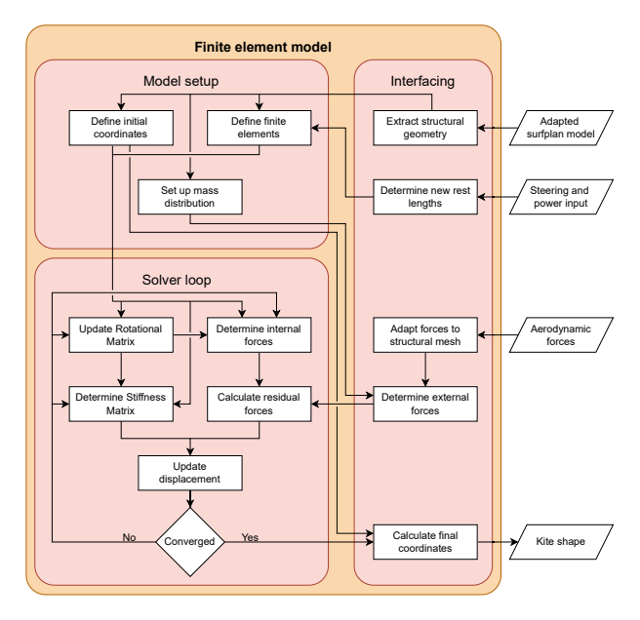
Nonlinear Finite Element Modelling
Convergence is reached when internal forces and external forces are balanced.
Each iteration, the rotational matrix, internal forces and the stiffness matrix are recalculated.
Geometric non-linearity and material non-linearity covered by this modelling approach
Force non-linearity resolved by coupling with an aerodynamic solver
Pyfe3d python library used for setting up finite elements and calculation stiffness matrix

Slide 7
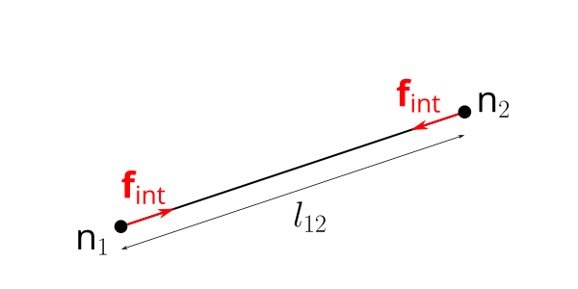

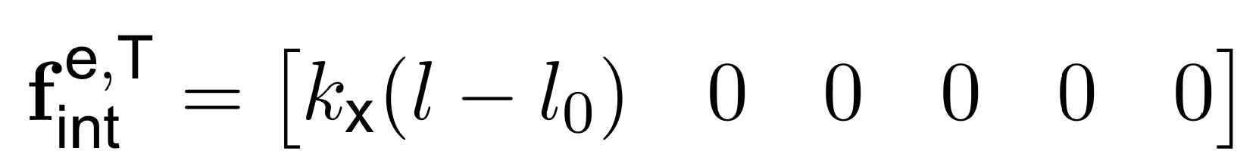
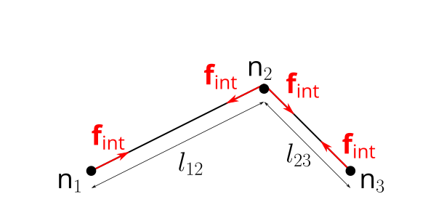
Spring Elements
Spring elements only have stiffness in the element’s x axis
To represent bridle elements, the spring stiffness can be set to 0 when the line is slack
Internal force calculation
A pulley can be modelled by combining two spring elements and sharing a single rest length and total length
Spring internal force calculation
Pulley internal force calculation

Slide 8
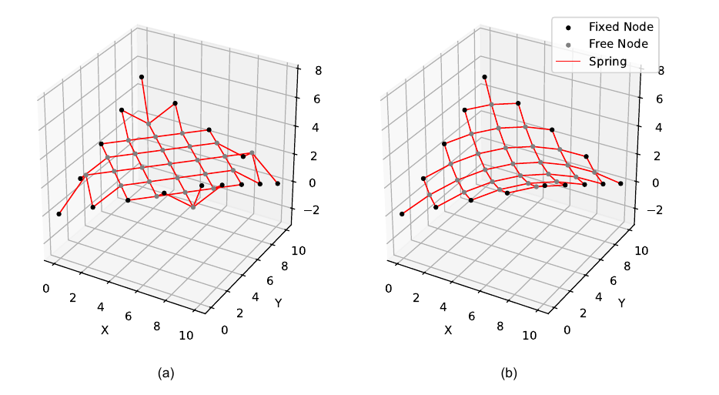
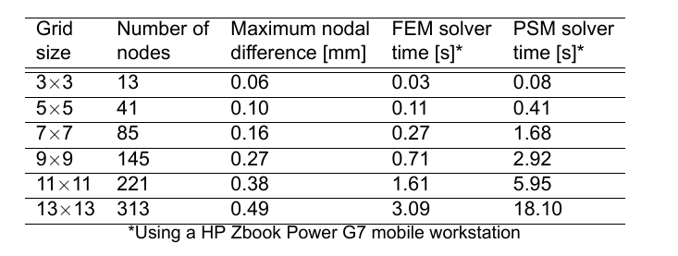
Spring Elements
Saddle problem for spring verification
Compared to python PSM solver
Initial shape
Final shape

Slide 9
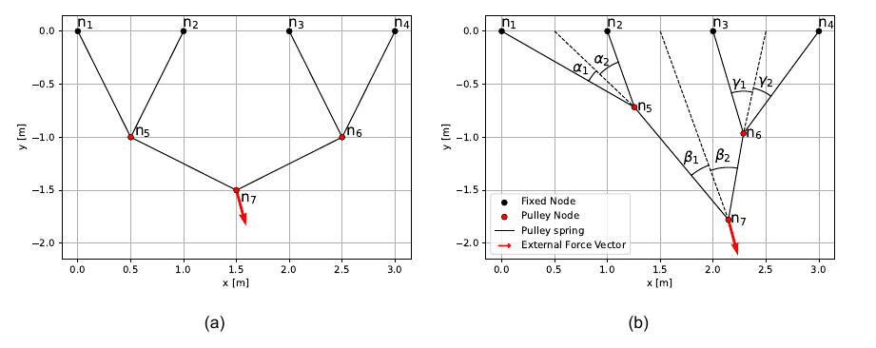

Spring Elements
Pulley verification by setting up system of pulleys
For a ideal pulley, angles between the force on the pulley and the corresponding lines are equal

Slide 10
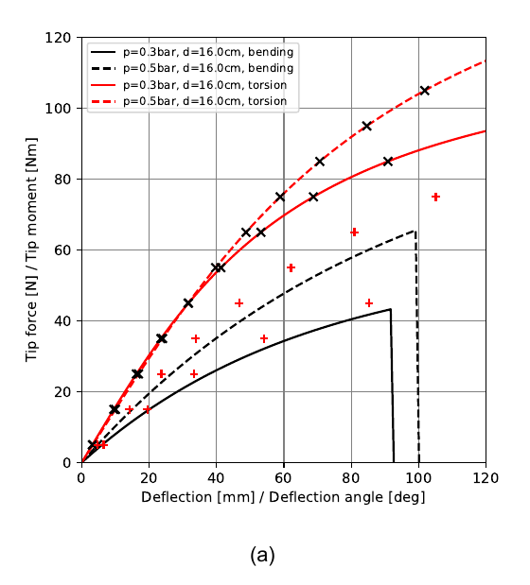


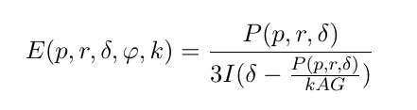

Beam Elements
Timoshenko beam elements used to represent the tubular frame
Breukels (2011) performed bending and torsional tests on inflatable beams and developed fitted equations to relate pressure, radius and deflection/rotation to tip load/torque
Beam properties E and G can then be updated using timoshenko beam theory
Comparison of a 1 meter beam element with Breukel’s equations

Slide 11
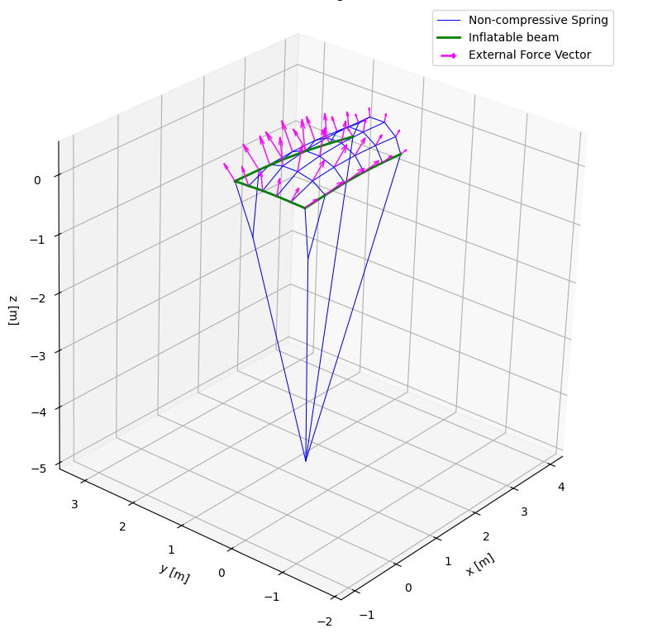
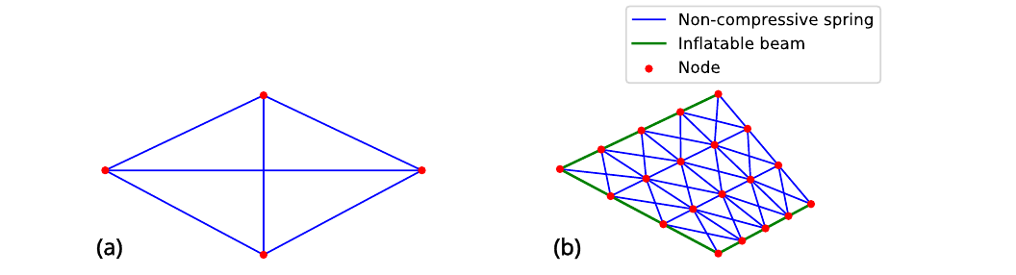
Canopy section
Canopy can be modelled by making quadrilaterals with 6 non-compressive spring connections
Quadrilateral representaiton of canopy
Example of canopy section with billowing

Slide 12
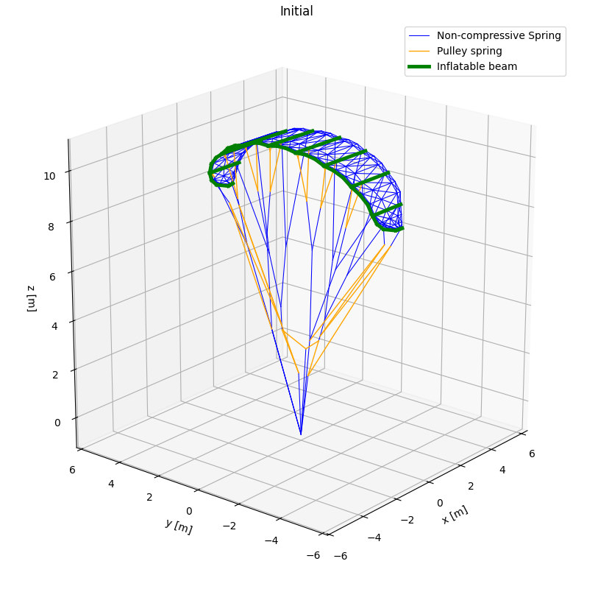
V3 Kite model
V3 Kite model set up using
surfplan → yaml → askite
pipeline
Some manual adaptations on the bridle system required, to get it in line with the recent testing data

Slide 13
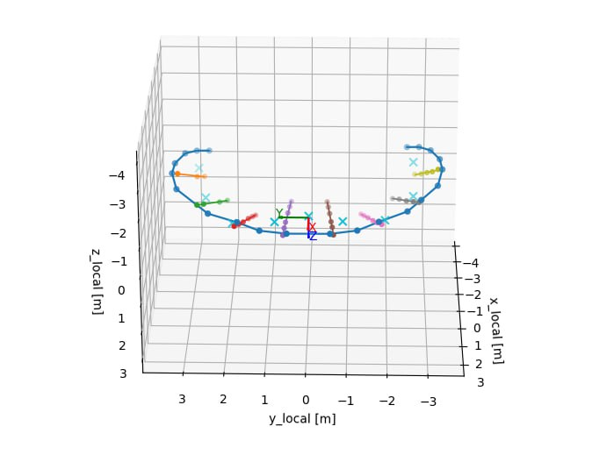
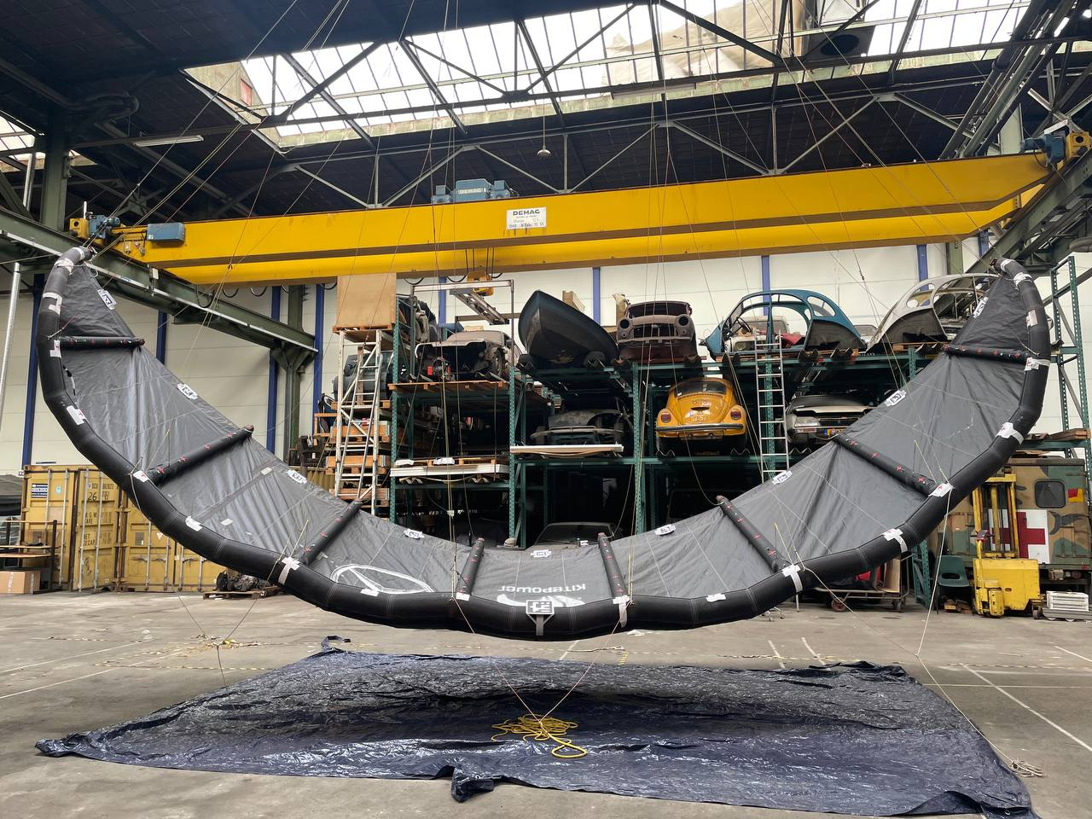
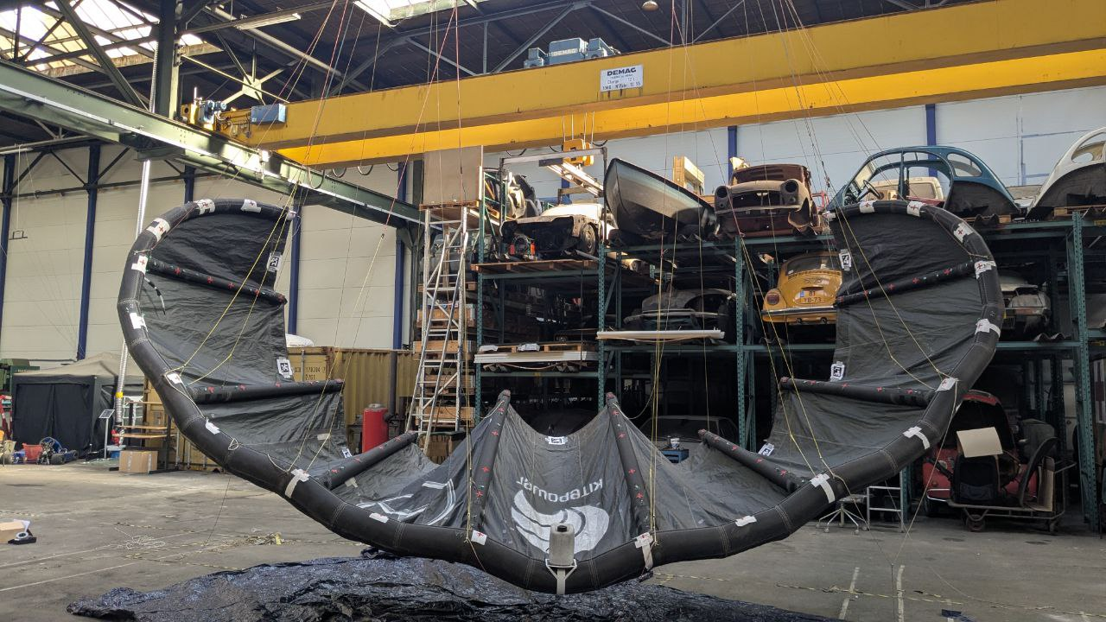
Static tests
Static tests performed together with Pim, to get validation data for the model.
Varied loads, and internal pressure.
Tip loads, pulling the tips apart
Point load on middle of leading edge

Slide 14
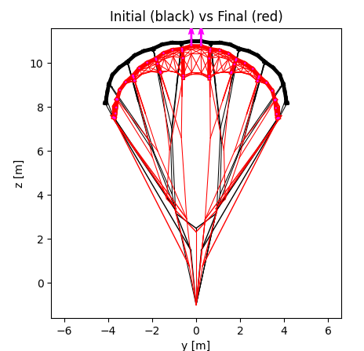
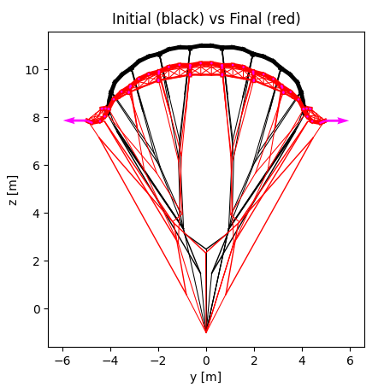
Static tests
Full comparison still to be done, kite behaviour to input seems visually correct
Still some convergence issues to iron out

Slide 15
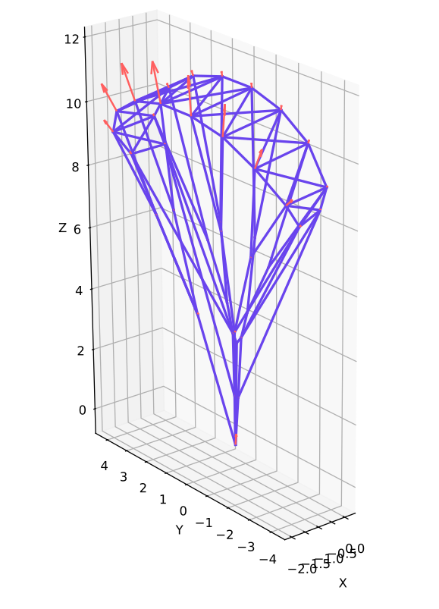
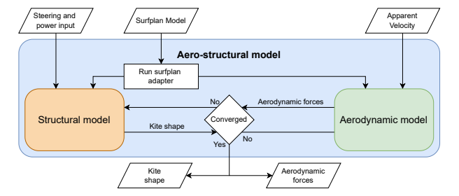
Aerostructural coupling
Model is to be fitted into existing Aero-structural framework (askite).
Will be combined with VSM
FEM framework partly integrated into askite, the simplified kite model can already be resolved with the model in askite

Slide 16
Afsluiter

